Slide 1
The COMPONENT View
Mapping Classes to Physical Software Artifacts – The Software Architecture of the system

Slide 2
Lecture Objectives
Definition of component view
Building blocks of component architecture
Determinants of component architecture
Development of component architecture
Component diagram

Slide 3
COMPONENT VIEW
This view concerns itself with the actual software module organization within the development environment
Also termed the IMPLEMENTATION View
It establishes the software artifacts that will be developed as deliverables of the project
It takes into account derived requirements related to:
  ease of development,
  software management and maintenance,
  re-use
  constraints imposed by hardware platform, operating system platform, programming languages and development tools

Slide 4
COMONENT VIEW
Key modeling artifacts of component view are:
  Package
  component
PACKAGES:
  A package is a physical partitioning of the system (cluster of use-cases, or classes that fulfill a specific workflow in the proposed system)
  Packages are then organized into a hierarchy of layers where each layer has a well defined interface

Slide 5
COMPONENT VIEW
COMPONENT
A software component is code that implements a set of well-defined interfaces
Can also be defined as a manageable, discrete chunk of logic
Components can exist on their own, however, rarely do they run on their own
They enhance reusability

Slide 6
COMPONENT VIEW
COMPONENT CONT.
A component architecture comprises of:
  Tools for developing components
  Containers for managing the deployed components
  Tools for deploying and maintaining components (e.g. customization tools, communication technologies and protocols, etc.)
The Object Oriented paradigm separates the INTERFACE of a component from its IMPLEMENTATION

Slide 7
COMPONENT VIEW
COMPONENT CONT.
A Component has 2 parts:
  INTERFACE:
    A component interface defines the component’s contract with the code that calls it
    It identifies the methods and parameters the component accepts
  IMPLEMENTATION
    A component implementation is the core programming logic that an object provides

Slide 8
COMPONENT VIEW
COMPONENTS CONT:
  In UML a source code component represents a software file that is contained by a package – it is made up of one or many classes coded together into a single program-file
  Components are language specific / dependent
    in C++, software components represent .h and .cpp files
    in Java, they represent .java files etc
  Classes in the Logical view are mapped to Components in the Component view
    in most languages, the mapping is 1:1
    in some situations, however, more that one class can be mapped into a component

Slide 9
COMPONENT VIEW
CUSTOMER
VEHICLE
RENTAL
RENTAL INVOICE
PART
EXAMPLES OF COMPONENTS

Slide 10
IDENTIFYING DOMAIN COMPONENTS
NB: The assumed architecture (see lecture on use-cases) is a component-based architecture
Using this architecture, the application’s logic derived in the ANALYSIS phase can be decomposed/classified into components
This is achieved as follows:
  1. Define a workflow component for each business process
  2. Define a use-case control component for each use-case
  3. Represent each external system as a component
  4. Combine related classes in the analysis model to form domain components

Slide 11
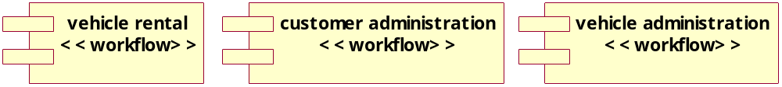
Define a workflow component for each business process
Business Processes are the Key functions found in an information system (as established during systems analysis)
Examples:
  Vehicle administration, Vehicle rental, Customer administration
Each business process entails many different classes and may include one or more use-cases
A workflow component is defined for each business process

Slide 12
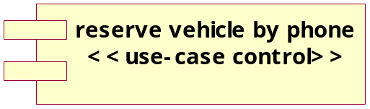
Define a use-case control component for each use-case
Each use-case in the use-case view represents an encapsulation of business-logic or system functionality that will be coded into executable programs, user interfaces, stored procedures etc.
Therefore, each use case is in itself a component – each represents a control component and is thus stereotyped “use-case-control”
Example: reserve vehicle by phone

Slide 13
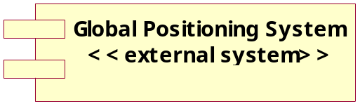
Represent each external system as a component
Some of the actors in the use-case view represent external systems
These external systems are artifacts and thus need to be represented as components
These types of components are termed External Components
Example: Global Positioning System

Slide 14
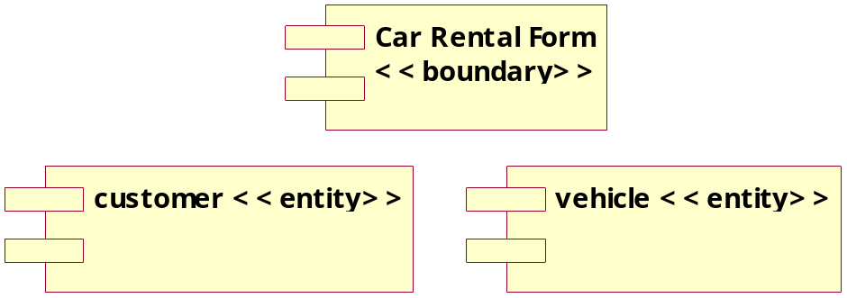
Combine related classes in the analysis model to form domain components
Another method for establishing components is to cluster together related classes
These types of components are termed domain components
Example,
  all related entity classes can be clustered into an entity domain component
  All classes participating in a user-interface may also be clustered into domain components

Slide 15

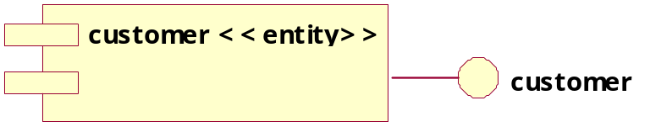
Define Interfaces for each component
Once the components are established, interfaces can be defined for each
The interface symbol is a lollipop
The number, and types of interface each component will have will be determined by the development technology (programming language) to be used in coding the system

Slide 16
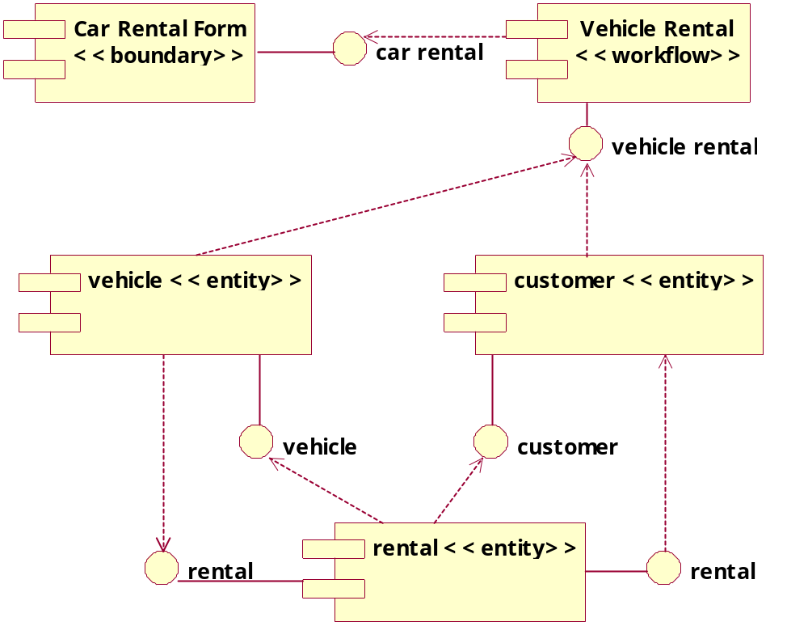
Elaborate Requisite Component Models

Slide 17
IMPLEMENTATION VIEW
To create components in Rational Rose
  open a component diagram
  click to select the component icon on the toolbar
  click on the diagram to place the component. This will also add the component to the browser
  while the component is still selected , enter the name of the component

Slide 18
IMPLEMENTATION VIEW
To map classes to components in Rational Rose:
  right click on the component in the browser and make the shortcut menu visible
  select the “open specification” menu choice
  select the realizes tab
  right-click to select the class and make the shortcut menu visible
  select the assign menu choice
  click on the OK button to close the specification

